Slide 1



Project1 AirBnB Investment
By: turki AlSughayyir, Abdullah alMalki

Slide 2
Should our investor invest in an Airbnb hotel in Washington, D.C.?

Slide 3
Data cleaning
Deleted columns ( URLs, photos, 0 properties total reviews, properties outside Washington DC)
Find values for (guest_included column.)
Replace blank cells in some reviews columns to zeros.

Slide 4
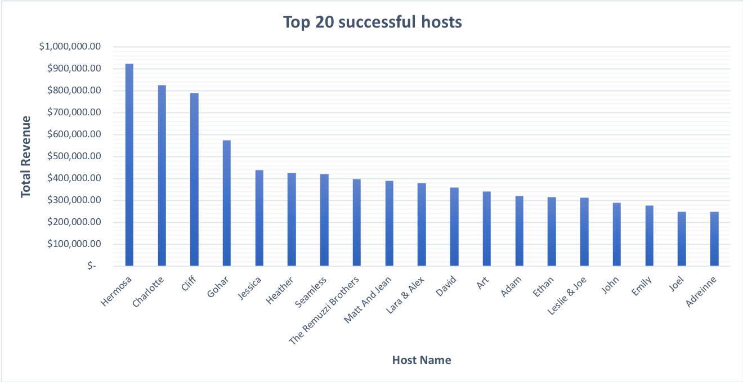
Prompt 1: How Much Revenue Do Successful Hosts Generate?

Slide 5
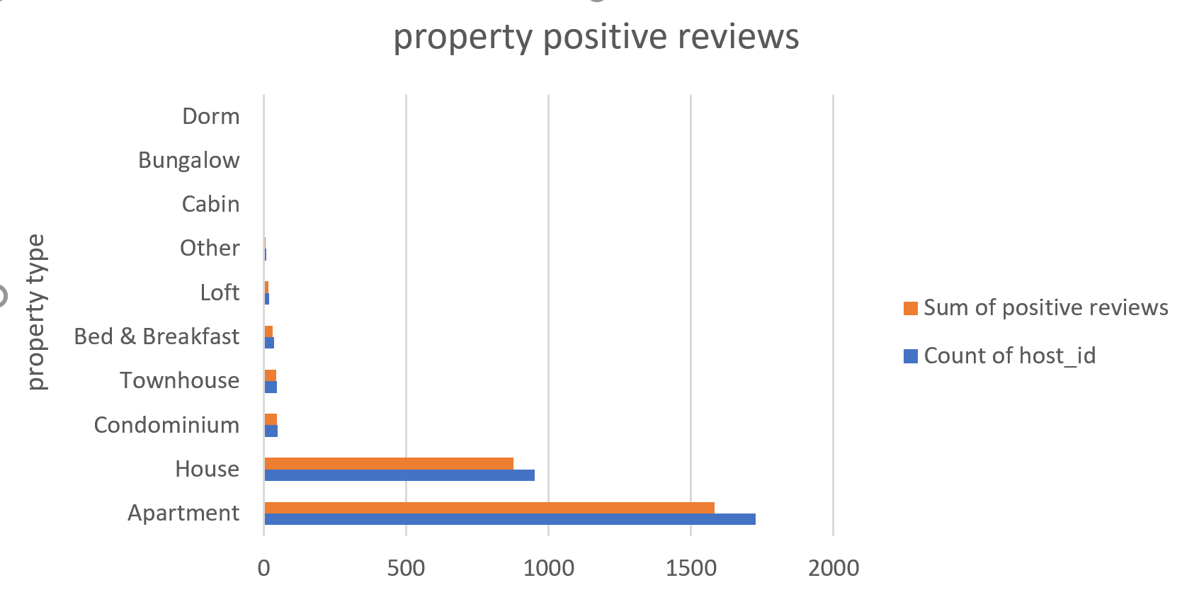
Prompt 2: Which property types receive the most positive reviews?

Slide 6
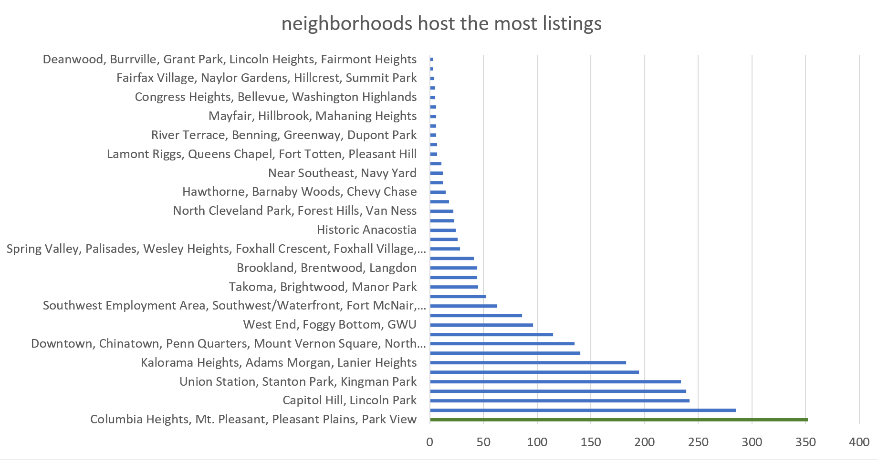
Prompt 3: Which neighborhoods host the most listings?

Slide 7
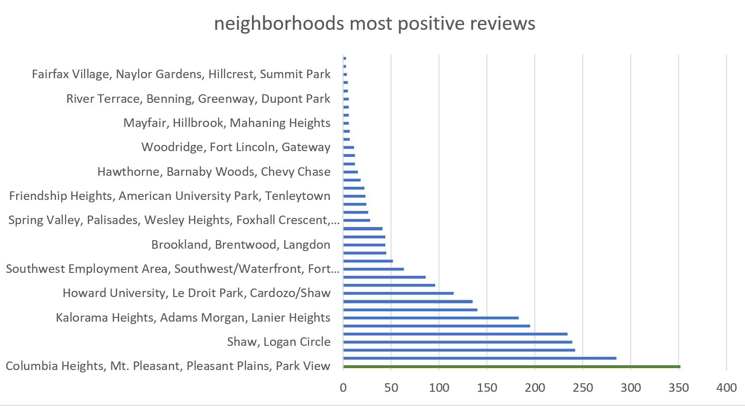
Prompt 4: Which neighborhoods receive the most positive reviews?

Slide 8


We recommend the investor to invest in
Dupont Circle, Connecticut Avenue/K Street
Capitol Hill, Lincoln Park
1st in top 10 neighborhood by revenue
2nd in top 10 neighborhood by revenue
2nd in top 10 neighborhood positive reviews.
3rd in top 10 neiborhood positive reviews.

Slide 9
Thank you!

